Slide 1
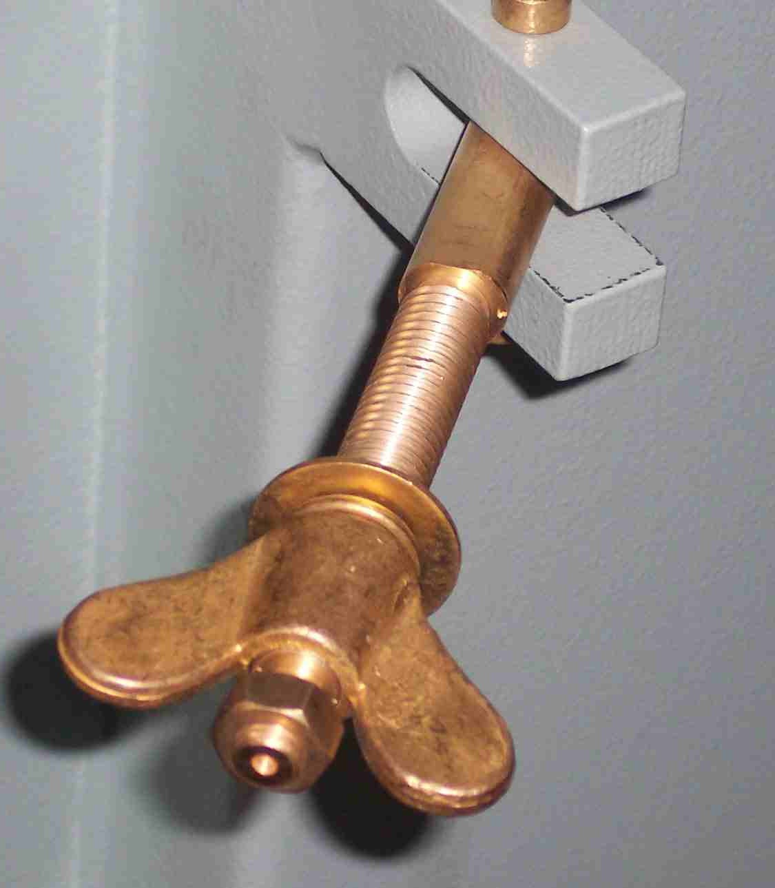
SIEMENS
HVCB SPARES
Locking Screw for panel
72.5KA,145KV & 245KV CB
S4799249001

